Slide 1
Welcome
K. SYED ABTHAHEER
MA.,M.Phil.,B.Ed.,PGDCA
Assistant Professor of English,
Jamal Mohamed College(Autonomous),
Trichy-20.
syedabutrichy@gmail.com
90426 80796

Slide 2
Parts of Speech

Slide 4
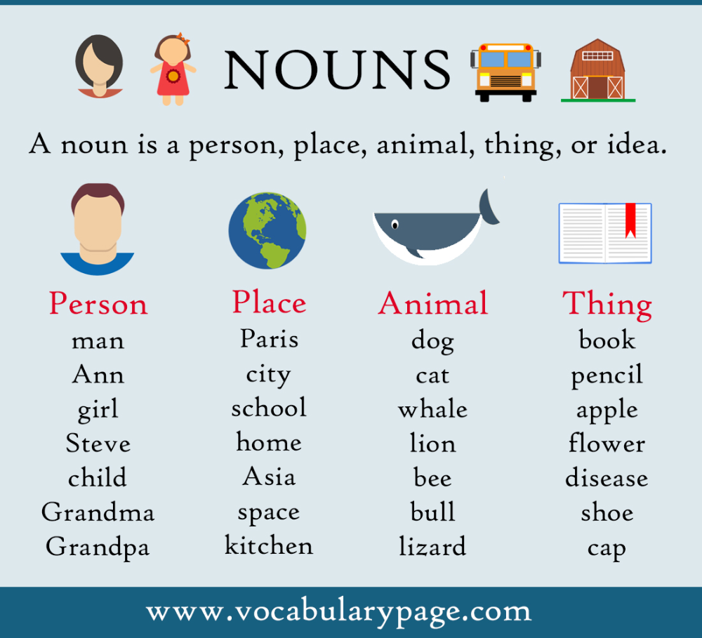
1.Noun
What is a noun?
A noun is a part of speech that is used to name or identify a person, place, thing or idea. A noun is a word that represents a person, thing, concept, or place (e.g., “John,” “house,” “affinity,” “river”).

Slide 5
2.Pronoun
What is a pronoun?
A pronoun is a word that is used instead of a noun or noun phrase. Pronouns refer to either a noun that has already been mentioned or to a noun that does not need to be named specifically.

Slide 6
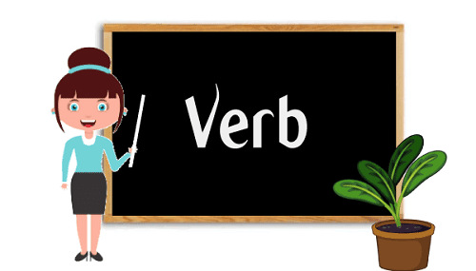
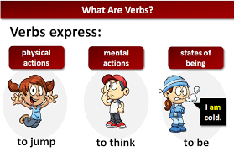
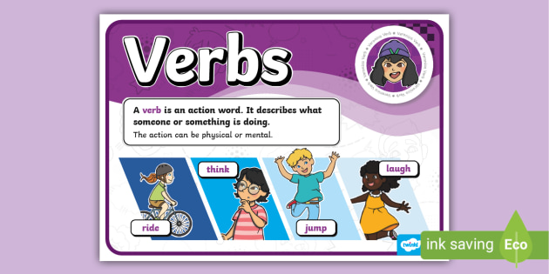
3.Verb
What is a verb?
Verbs are words that show an action (sing), occurrence (develop), or state of being (exist). Almost every sentence requires a verb. The basic form of a verb is known as its infinitive. The forms call, love, break, and go are all infinitives.

Slide 7
4.Adverb
What is called adverb?
An adverb is a word that can modify or describe a verb, adjective, another adverb, or entire sentence. Adverbs can be used to show manner (how something happens), degree (to what extent), place (where), and time (when).

Slide 8
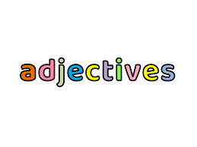
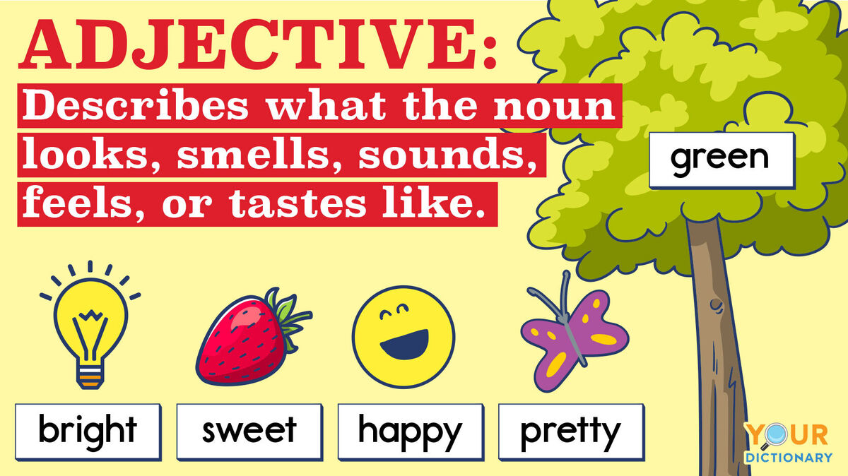
5. Adjective
What is adjective and example?
An adjective is a word that modifies or describes a noun or pronoun. Adjectives can be used to describe the qualities of someone or something independently or in comparison to something else.

Slide 9
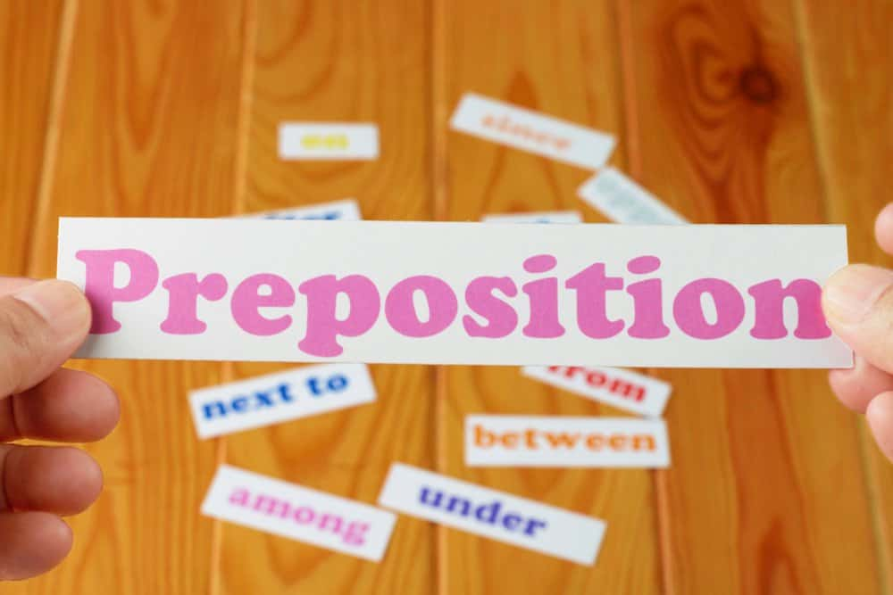
6. Prepositions
What is a preposition and examples?
A preposition is a word or group of words used before a noun, pronoun, or noun phrase to show direction, time, place, location, spatial relationships, or to introduce an object. Some examples of prepositions are words like "in," "at," "on," "of," and "to."

Slide 10
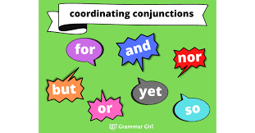
7. Conjunction
What is conjunction and example?
A conjunction is a word used to connect words, phrases and clauses. Common examples of conjunctions include and, but and or, although there are many other possibilities (including although).

Slide 11
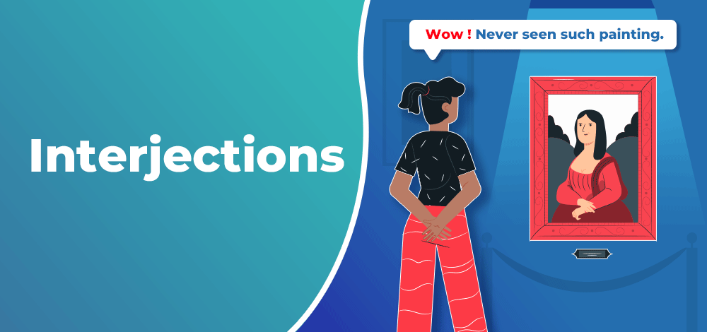
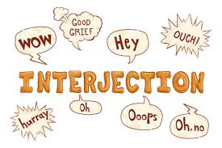
8. Interjection
What is called interjection?
An interjection is a word or phrase used to express a feeling or to request or demand something. While interjections are a part of speech, they are not grammatically connected to other parts of a sentence. Interjections are common in everyday speech and informal writing.

Slide 13
K. SYED ABTHAHEER
MA.,M.Phil.,B.Ed.,PGDCA
Assistant Professor of English,
Jamal Mohamed College(Autonomous),
Trichy-20.
syedabutrichy@gmail.com
90426 80796

